Slide 1
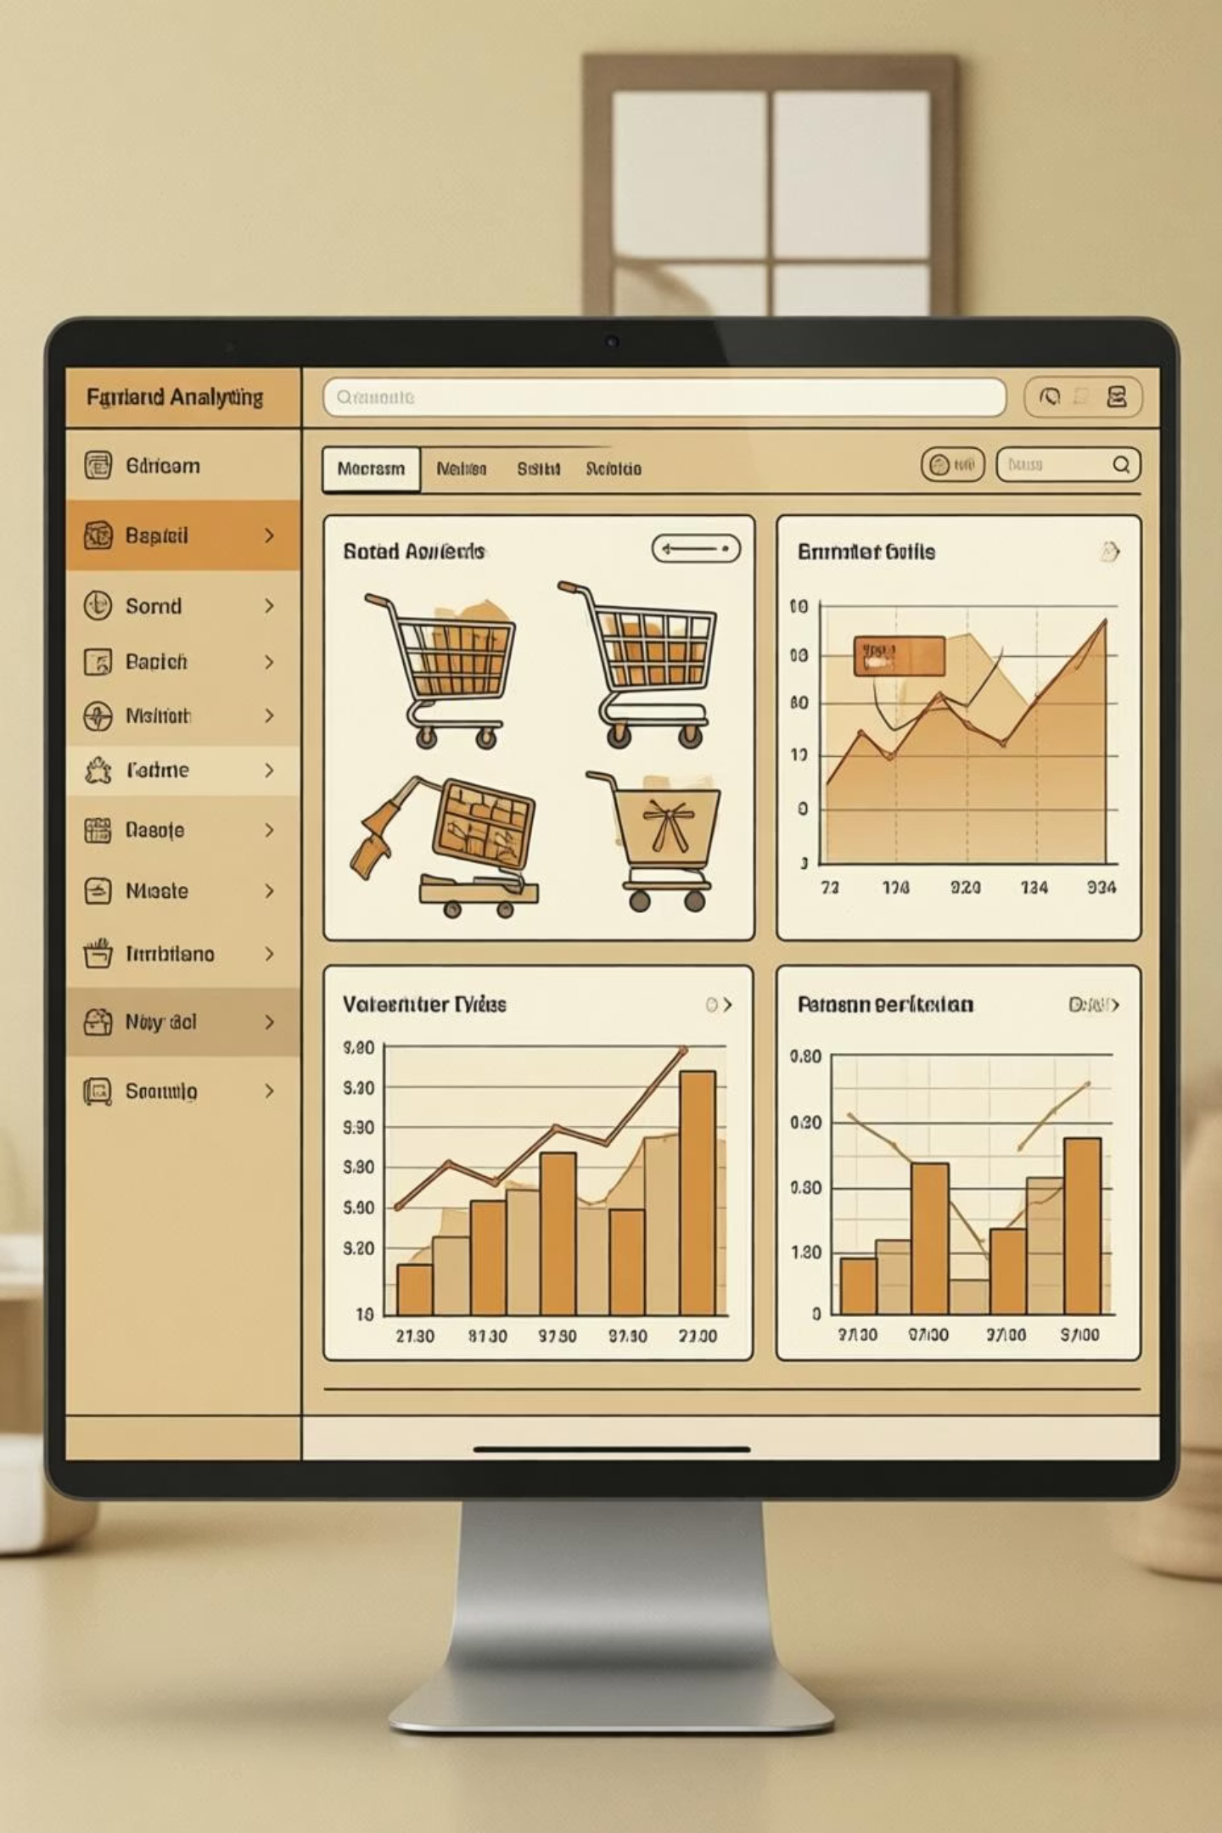
Customer Shopping Behavior Analysis
Uncovering insights from 3,900 purchases to guide strategic business decisions

Slide 2
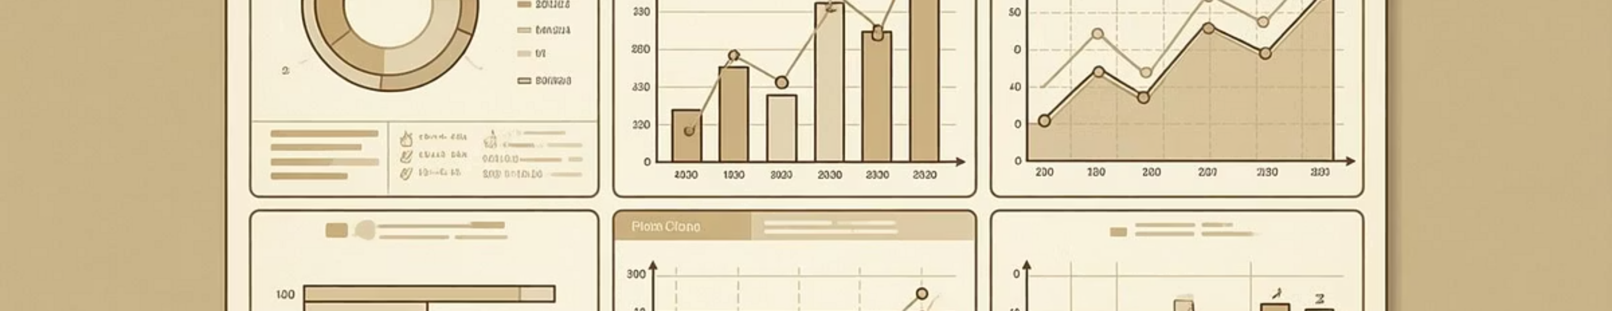
DATASET OVERVIEW
The Data Behind the Insights
3,900
18
50
25
Total Purchases
Data Points
Locations
Products
Transactions analyzed across all categories
Features per customer transaction
Geographic coverage
Unique items tracked

Slide 3

PYTHON ANALYSIS
Data Preparation & Cleaning
01
Data Loading
Imported dataset using pandas for analysis
02
Missing Data
Imputed 37 missing review ratings using median values
03
Feature Engineering
Created age groups and purchase frequency metrics
04
Database Integration
Loaded cleaned data into PostgreSQL

Slide 4
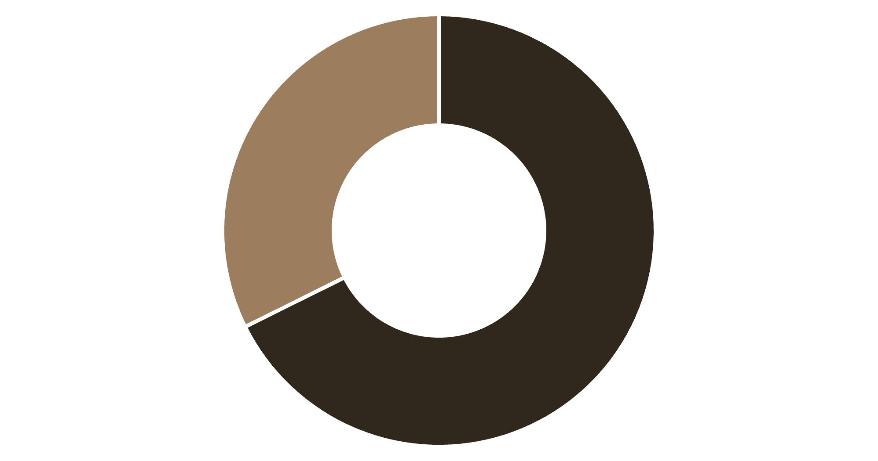
REVENUE INSIGHTS
Gender Revenue Comparison
Male customers drive 68% of total revenue
Significant opportunity to increase female customer engagement and spending
Male
Female

Slide 5
Top Products by Customer Rating
77%
77%
Gloves
Sandals
Highest rated at 3.86 stars
Strong performance at 3.84 stars
76%
76%
Boots
Hat
Solid rating of 3.82 stars
Customer favorite at 3.80 stars

Slide 6




CUSTOMER SEGMENTS
Understanding Our Customer Base
Returning
701 customers
Loyal
Growing engagement potential
3,116 customers
Repeat buyers driving consistent revenue
New
83 customers
Fresh acquisition opportunities

Slide 7
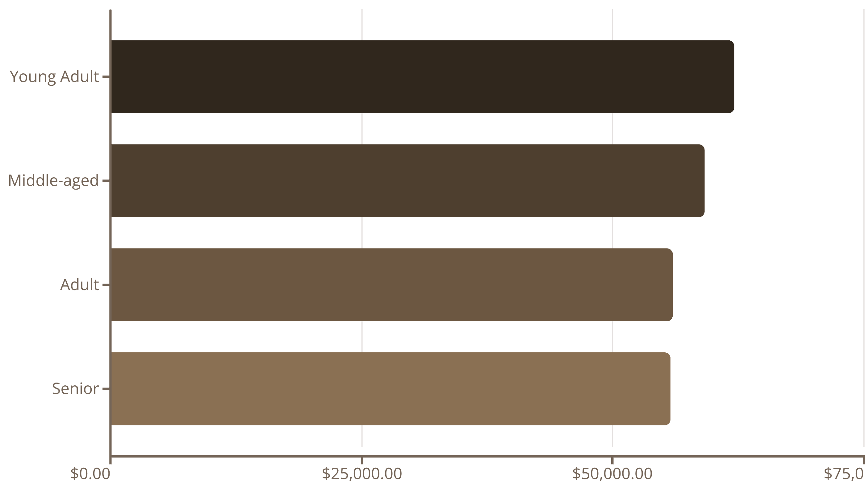
Revenue by Age Group
Young adults lead revenue generation, but all segments show strong engagement

Slide 8

SUBSCRIPTION ANALYSIS
Subscribers vs. Non-Subscribers
Subscription Status
Key Finding
27% subscribed customers
Repeat buyers with 5+ purchases show higher subscription rates
73% non-subscribers
Similar average spend: $59.49 vs $59.87
Opportunity to convert loyal customers into subscribers

Slide 9

CATEGORY PERFORMANCE
Sales & Revenue by Category
Clothing
Accessories
$100K revenue
$80K revenue
1,800 sales
1,200 sales
Top performer across all metrics
Strong secondary category
Footwear
Outerwear
$40K revenue
$20K revenue
600 sales
300 sales
Steady performance
Growth opportunity

Slide 10





ACTION PLAN
Strategic Recommendations
Boost Subscriptions
Promote exclusive benefits to convert loyal customers
Loyalty Programs
Reward repeat buyers to increase retention
Targeted Marketing
Focus on high-revenue age groups and express shipping users
Product Positioning
Highlight top-rated items in campaigns

